Slide 1
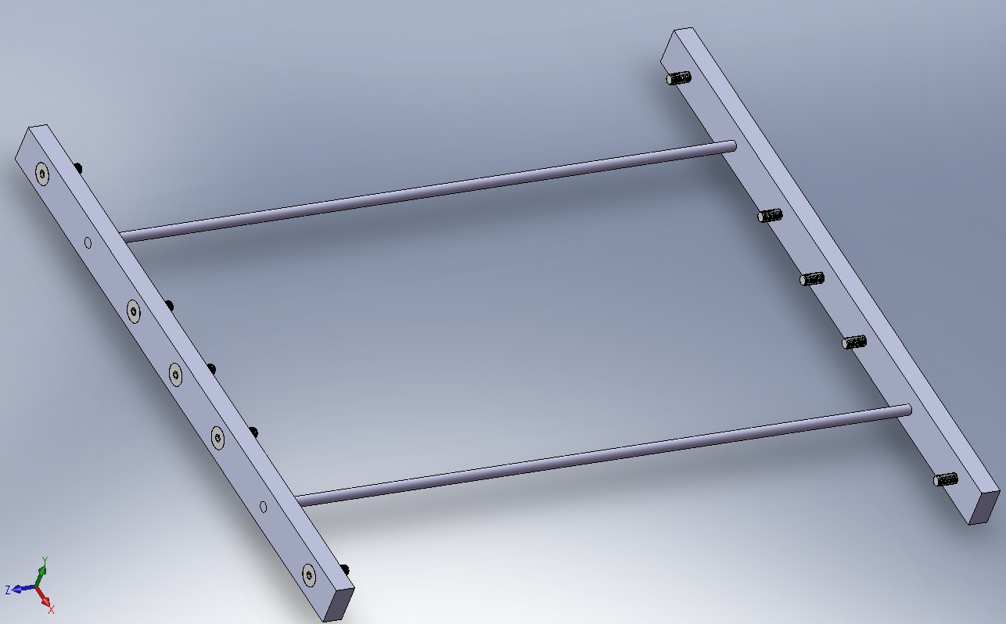
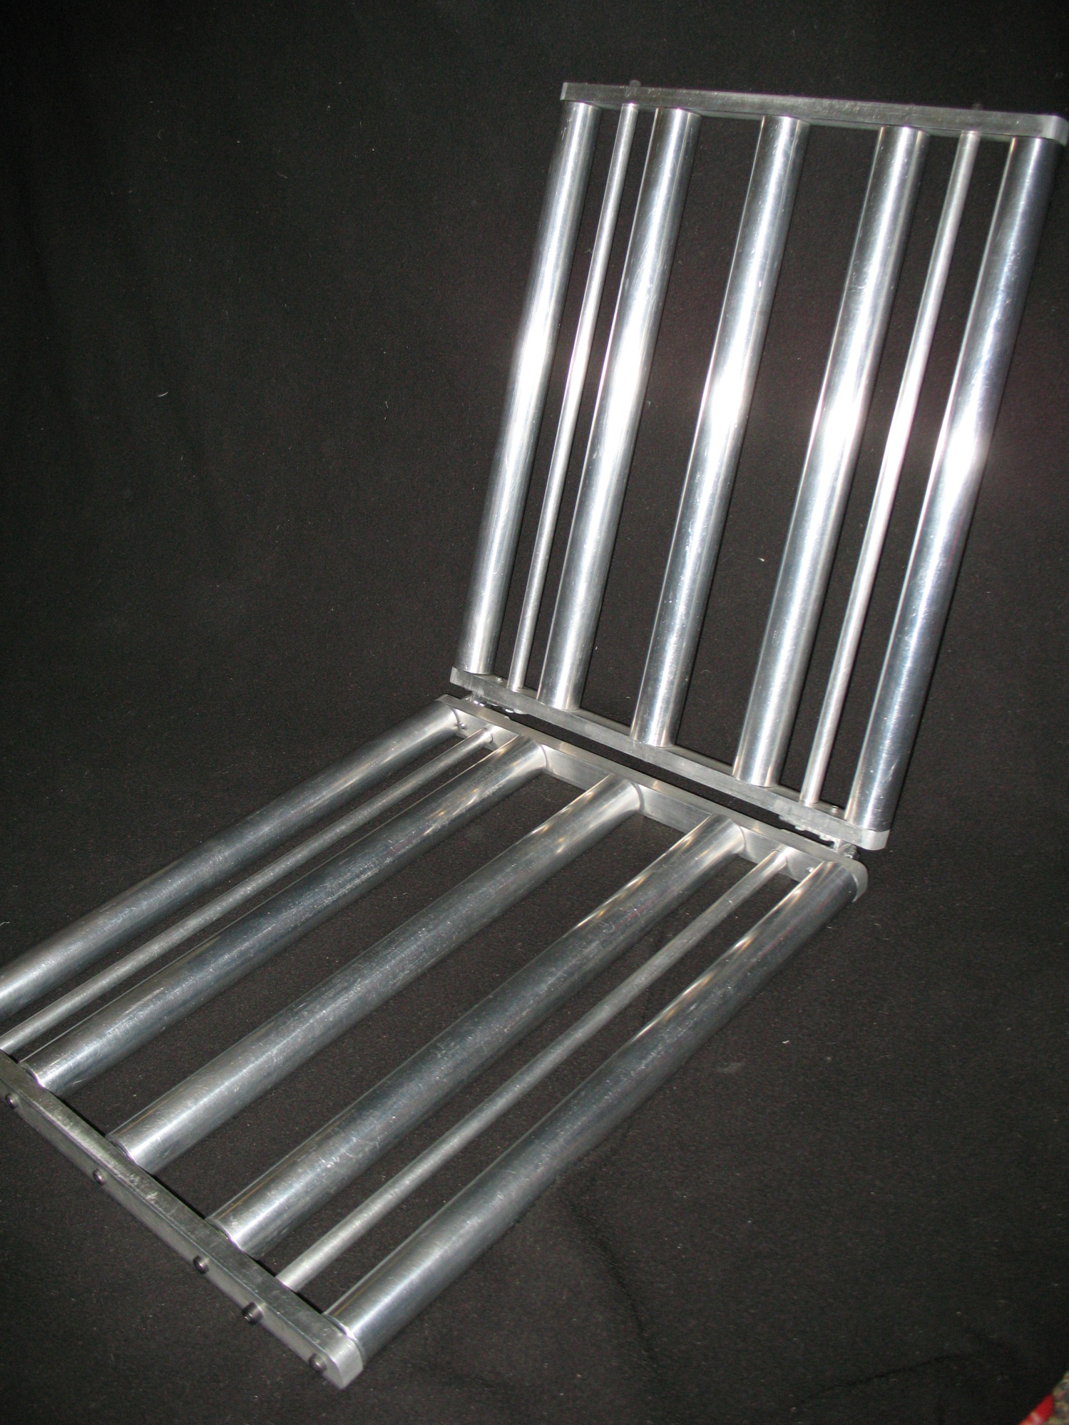
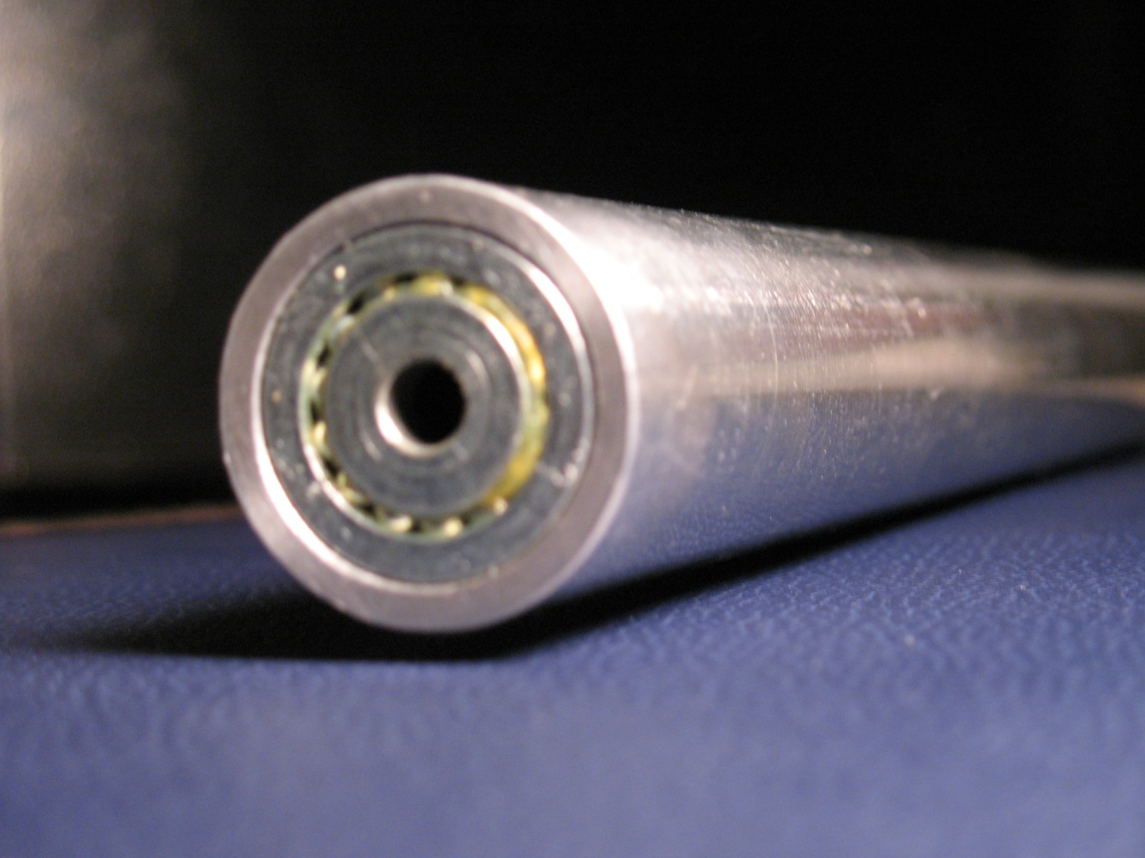
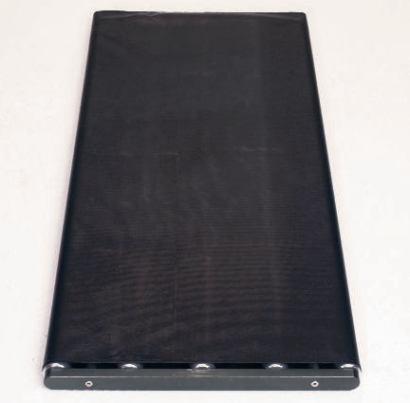
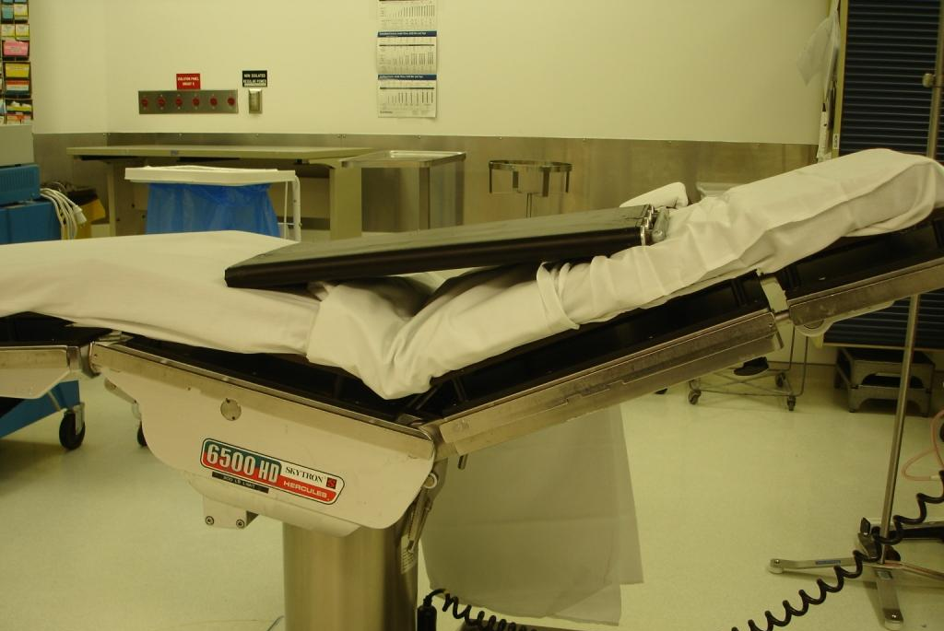
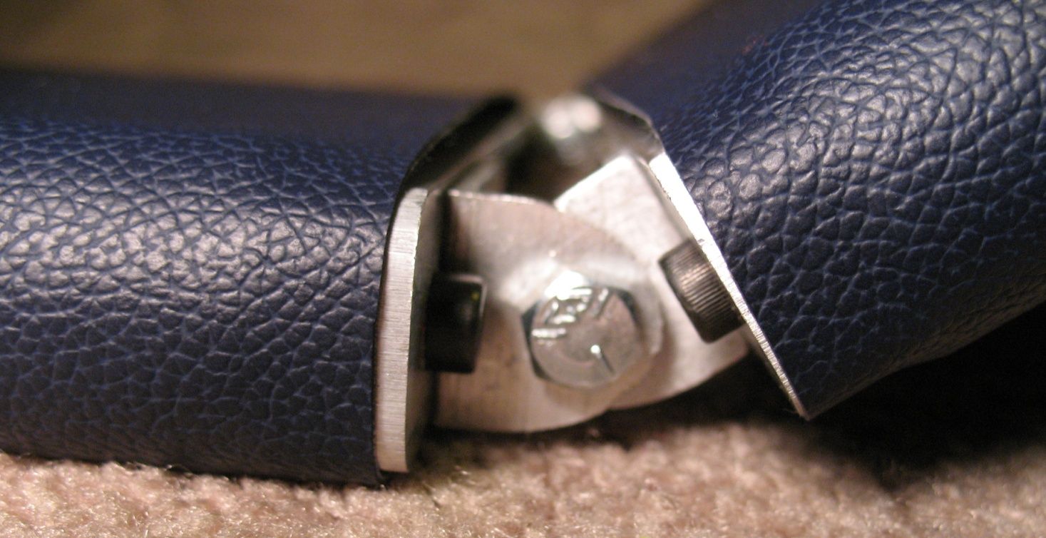
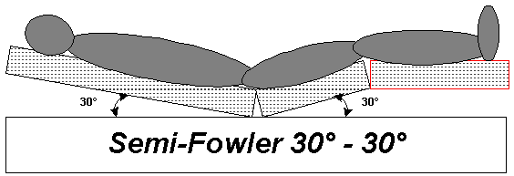
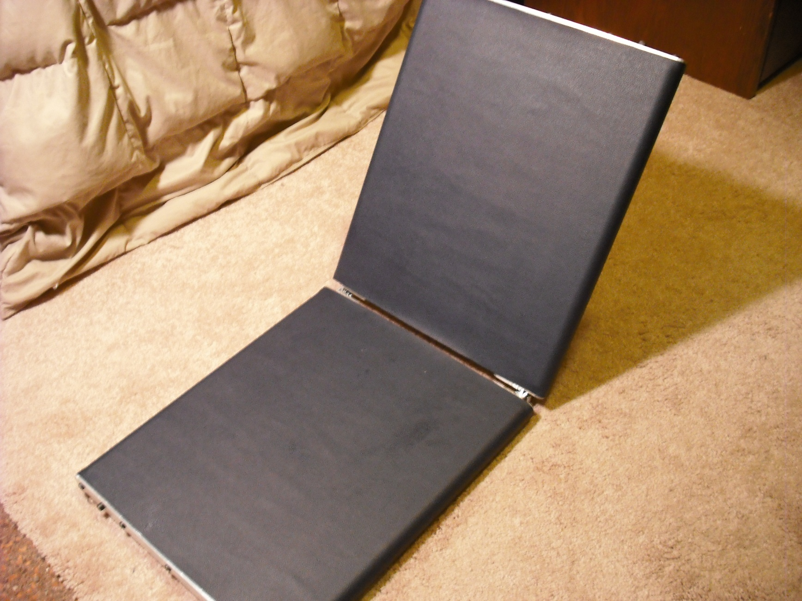
Patient Transfer Device
Justin Gearing, Jamon Opgenorth, Alex Bloomquist, and Dan Miller
Client: Dr. Ashish Mahajan
Advisor: Professor Brenda Ogle
Abstract
Final Design
Testing
Our client, Dr. Ashish Mahajan, requested that we design and produce an articulating roller device to help transport patients from the operating table to a hospital bed. Dr. Mahajan is currently using a flat roller board to transport sedated patients in the semi-fowler position. This causes problems as the patient has multiple angles of weight distribution.
The final design is two boards hinged at the center, allowing it to efficiently transport patients in the semi-fowler position. Roller bearings allow for smooth transport with minimal effort by medical staff. The device will be easily stored on a hook behind the door in the hospital room.
Careful attention was paid to the staff-product interaction with this device. The overall weight is 14.9 lbs allowing easy transportation by a single person. The device was also designed to be completely symmetrical allowing any medical staff to use the product correctly without any prior knowledge or background with the device.
The roller boards were tested and easily withstood 300 lbs without any deflection. Future work includes modifying the hinge to allow the device to completely fold up upon itself.
Rod
Product Weight =14.9 lbs
Placed +300 lb load on one board, there was no visible deflection.
Inspected entire device for sharp edges and corners.
Tested original prototype, hinges caught on the sheets being used to transport. We shortened the hinges, and no further problems occurred following the fix.
Conducted performance testing at UW hospital in semi-fowler and flat position with client. The client commented that he thought it was more efficient than any of the purchased single-flat boards.
Machine bolt
Roller
Plate
Figure 2.a Basic structure (above)- The basic structure for each roller is comprised of two rods (0.5” OD) and two aluminum plates (14.5”x1”x0.5”). Each plate is threaded for five machine bolts (1” long, 1/4”-28 thread), which hold each roller in place.
Figure 2.b Frame of final design (right)- Each component is made of 6061 aluminum and were machined exclusively in the COE Student Shop. The only non-aluminum pieces consist of the steel bolts used to hold the rollers in place and the ball bearings.
Hinge
Introduction
Chart 1 Force Graph- Graph of average force needed to move 150 lbs at a constant speed. Five measurements for each device were taken showing a statistically significant difference in the average force needed to transfer a patient (p-value = 4.98e-7). Our device reduced the force needed to transport a patient by 67. 28% over our clients previous device.
After a surgery is preformed, patients need to be transferred from the operating table to a transportable bed. This task is typically accomplished by using a roller board (Figure 1.a) while the patient lies flat. However there are situations when a patient must remain in the semi-fowler position (Figure 1.b) during post-op. This makes it very difficult to transfer a patient using a flat roller board (Figure 1.c). Our client requested that we design a transfer device that transfers patients safely and effectively from an operating table to a bed in the semi-fowler position.
Ergonomics
Figure 3 (left)- Roller with bearings. Each roller consists of an aluminum tube with a bearing fitted in each end. The bearings rest on a shelf inside the tubes, and are securely fastened with Locktite. The bearings rotate around ¼”-28 bolts that are threaded into each endplate.
Operators and Patients:
Safety
-No sharp corners or edges
-Easy to store
Comfort
-Easy to carry
- Better distribution of weight
Ease of use
-Light weight
-Symmetrical properties
-Same thread size for all bolts (1/4”-28)
Performance
-Ball bearings
-Hinge
Aesthetics
-Slim design
-Uniform material
-Countersunk bolts
-Complementary and appealing colors
Ball Bearing (1.06” OD)
Aluminum Tubing (1.25” OD)
Figure 1.a (top left) Standard patient transfer device roller board (www.universalmedicalinc.com). Fig 1.b (bottom left) Semifowler position (www.decubitus.be). Fig 1.c (top right) Standard roller board is not optimal for the semifowler position.
Figure 4 (right)- The “L” hinge allows for 90 degree rotation on either side of the device. The hinge is a unique way to allow for simple transport of patients that must remain in the semi-fowler position during transport.
Future Work
-Further Testing:
~Long term use
~Implemented use
-Streamline manufacturing time
-Cut Costs
-Market research
~Improve hinge
Design Criteria
-Safe
-User friendly
-Durable
-More efficient than current process
-Easy to store
-Lightweight
-Easy to maintain
-Used at various angles/positions
-Hold up to 300 lbs
-Replaceable parts
Figure 5 (left)- Overall Design. The patient transfer device consists of two roller boards connected by two L-hinges. Each roller board consists of five rollers and a vinyl cover. The entire design was fabricated in the College of Engineering’s Student Shop.
Vinyl Cover
Roller Board
References
L-Hinge
www.decubitus.be
www.universalmedicalinc.com
Wang, H., Kasagami, F. “A Patient Transfer Apparatus Between Bed and Stretcher” Feb. 2008
We would like to especially thank:
Dave Bloomquist
Cathy Miller

