Slide 1
Blinking Orbital Prosthesis
Carmen Coddington
Bryan Jepson
Elise Larson
Michelle Tutkowski
Greg Gion-Medical Art Prosthetics
Willis Tompkins- BME Department

Slide 2
Points of Interest
Client Information
Background
Problem Statement
Design Criteria
Competition
Design Alternatives
Final Design
Future Work
Questions

Slide 3
Client Information
Greg Gion
Medical Art Prosthetics Clinic
Prosthetic ears, noses, eyes, fingers, hands, etc.
Provide most life-like restoration as possible
http://www.medicalartprosthetics.com/content.php?page=prostheses

Slide 4
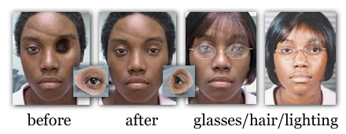
Background
Many causes for eye loss
Orbital prosthetics give a more natural appearance
Prosthetics do not blink
http://www.medicalartprosthetics.com/content.php?page=prostheses&sec=orbital

Slide 5
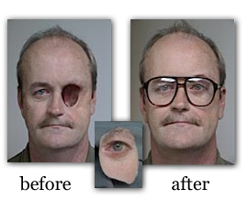
Problem Statement
Orbital prosthesis that blinks on command
Blinks reliably
Primarily self-contained
External controller
Natural appearance
http://www.medicalartprosthetics.com/content.php?page=prostheses&sec=orbital

Slide 6
Design Criteria
Blinks reliably on command
Contained in 5.5 cm³
Weigh <45 g
No detrimental health effects
Maintained easily
$500 budget

Slide 7
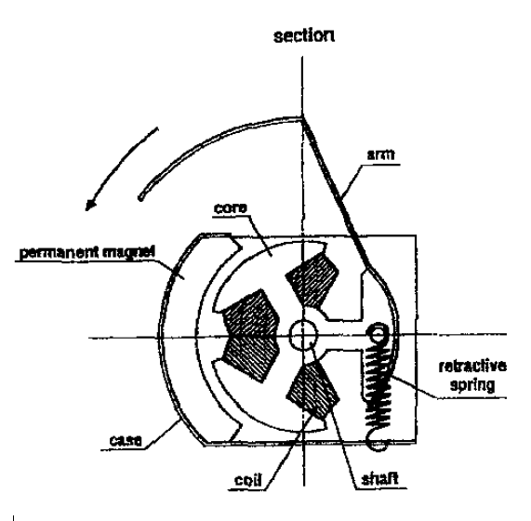
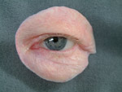
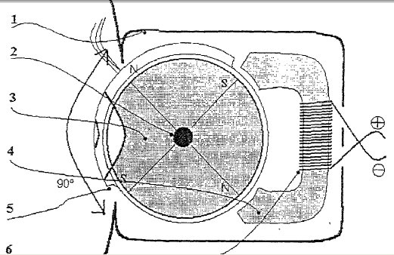
Competition
Electromagnetic Activator
Doll’s Eyelid
US Patent 20020049023
Non-Blinking Prosthesis
http://www.sciencedirect.com.ezproxy.
http://www.freepatentsonline.com/20020049023.pdf
http://www.medicalartprosthetics.com/content.php?page=galleries&gallery=orbital

Slide 8
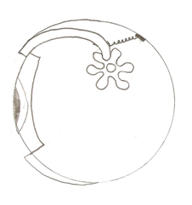
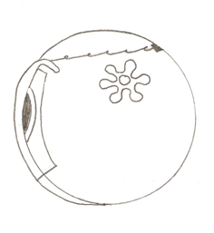
Mechanical Wind-Up
Open
Spring
User winds mechanism
Blink controller releases one gear at a time
Spring provides quick retraction of lid
Limited blinks per insertion
Gear
Shell
Closed
1 cm
1.1cm

Slide 9
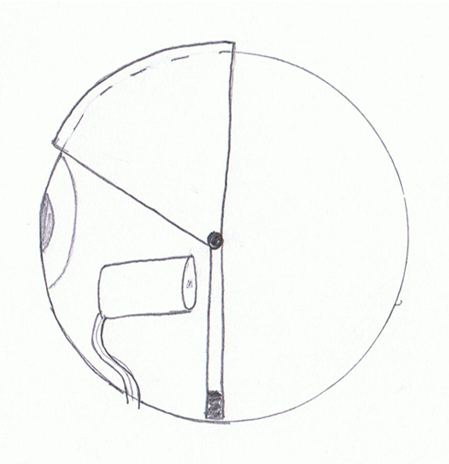
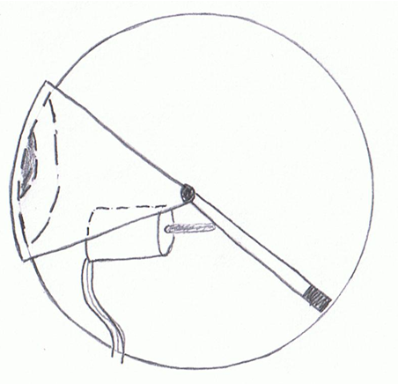
Push Solenoid
Open
Eyelid rotates on central axis
Tubular, push type solenoid rotates eyelid
Eyelid “closed” when solenoid powered on
Counterweight opens eyelid
Battery powered with on/off switch
Solenoid
Power Supply
Counterweight
Closed
1.1cm
1 cm

Slide 10
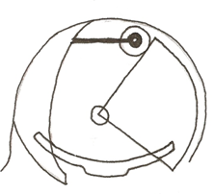
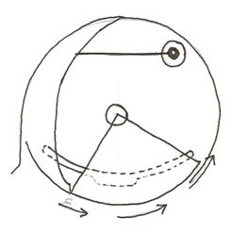
Pneumatic
Open
Balloon
Eyelid rotates on central axis
Inflated balloon catheter rotates eyelid
Manually powered with an air bulb
Counterweight opens eyelid
Closed
1 cm
1.1cm

Slide 11
Design Matrix
Criteria | Weight | Pneumatic |  | Wind-Up | Push Solenoid
Feasibility | 1 | 4 | 2 |  | 3
Size | 1 | 3 | 4 |  | 4
Reproducible | 0.3 | 3 | 3 |  | 3
Safety | 0.7 | 4 | 4 |  | 3
Cost | 0.3 | 4 | 3 |  | 2
Risk of Failure | 0.6 | 3 | 1 |  | 2
Appearance | 0.3 | 3 | 3 |  | 3
TOTAL |  | 14.30 | 11.90 |  | 12.45

Slide 12
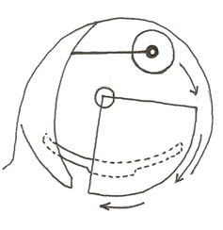
Final Design
Open failure mode
Eye glasses conceal air tube
Open
Closing
Closed
300 ms

Slide 13
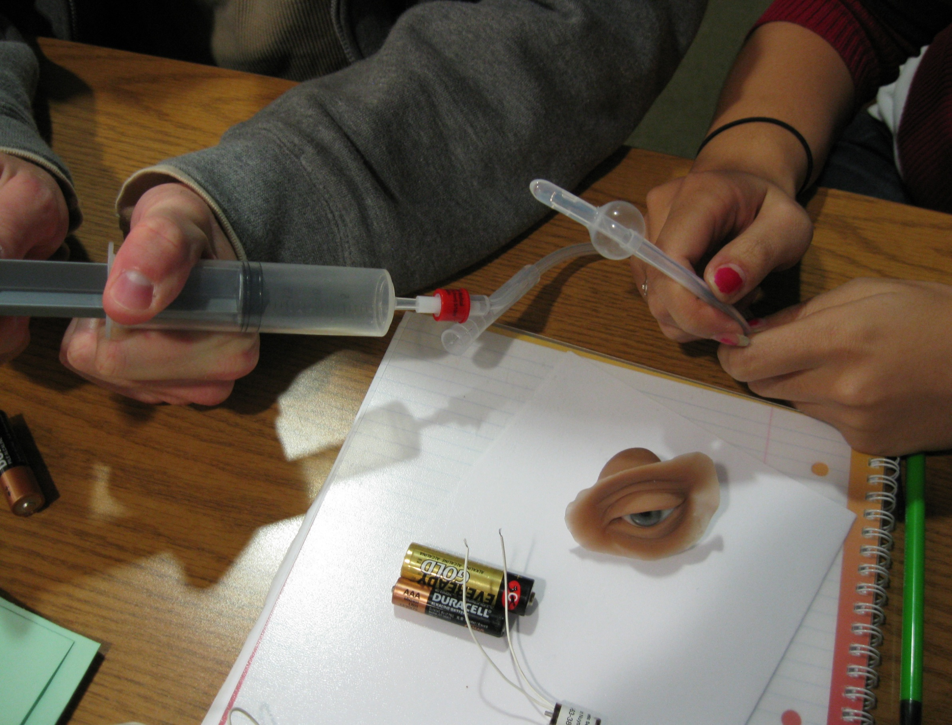
Future Work
Finalize Retraction Mechanism
Testing
Large-scale proof of concept
Force-weight –retraction balance
Fabrication
Minimize catheter size
Minimize deflation time
Maximize force exerted upon expansion

Slide 14
References
M.Honda, A.Niimi, M.Ueda“New Orbital Prosthesis With a Blinking Eyelid: Report of a Case” Journal of Oral and Maxillofacial Surgery, Volume 57, Issue 6, Pages 730-733
http://www.sciencedirect.com.ezproxy.library.wisc.edu/science?_ob=MImg&_imagekey=B6WKF-4CRR5T0-F0-1&_cdi=6905&_user=443835&_orig=search&_coverDate=06%2F30%2F1999&_sk=999429993&view=c&wchp=dGLzVlz-zSkzk&md5=3031db4f5557f4f0e54f082b1d6f4444&ie=/sdarticle.pdf
http://www.freepatentsonline.com/20020049023.pdf
http://www.medicalartprosthetics.com/content.php?page=galleries&gallery=orbital

Slide 15
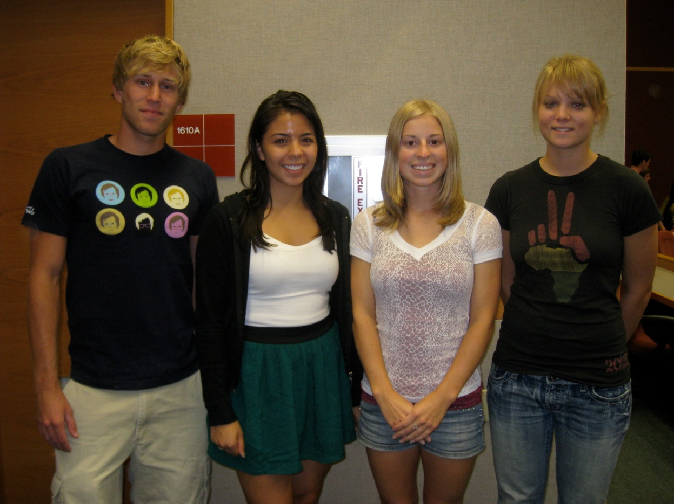
Questions?

