Slide 1
EWH Project: Liquid Medication Delivery System
Team Members:
Allison McArton
Angwei Law
Jonathan Meyer
Grant Smith
Padraic Casserly
Advisor: Dr. John G. Webster, Ph.D.
Client: Engineering World Health

Slide 2
Background
2.1 million children are affected by HIV
Boehring Ingelheim developed anti-transmission drug: nevirapine
Packets of the drug are given to expectant HIV+ mothers
Pharmacies need a way to accurately dispense the medication into packets

Slide 3
Problem Statement
Liquid medication bottle-top dispenser
Sterilely deliver fixed doses of liquid nevirapine into foil packages

Slide 4
Design Specifications
Dispense 0.6mL (± 0.05mL) of medicine
Accurately deliver 400 doses; operable for 6 months
Seal medicine bottle and prevent contamination
Cost less than $2.00

Slide 5
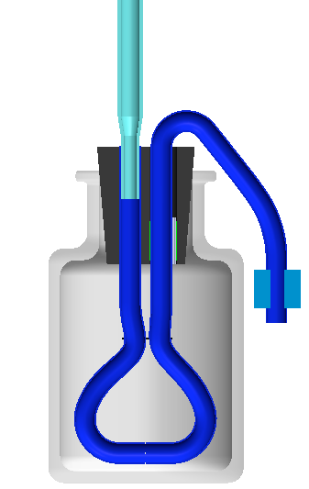
Previous Work
Based on fluid resistance
Requires precise manufacturing
Not tested with viscous fluid
(Feest, Maharaj, Mogen, Cira, 2008)

Slide 6
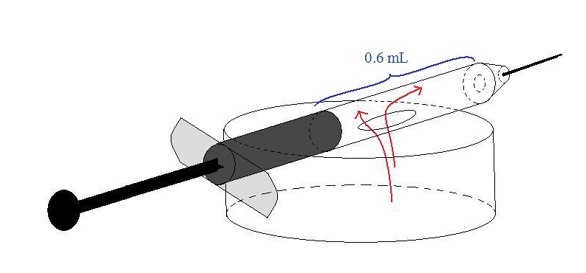
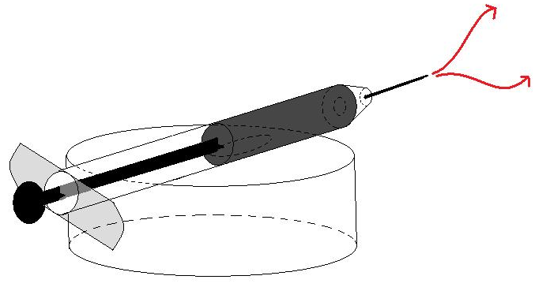
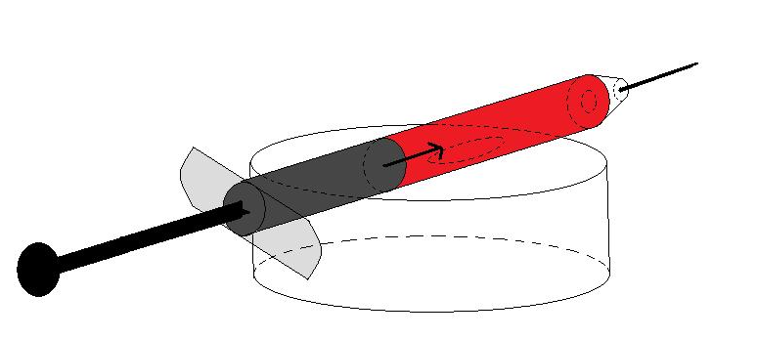
Design 1: Horizontal Syringe
Pros
Cons
Simple to sterilize
Must flip upside down to use
Requires manufacturing
Viscous liquid may reduce accuracy

Slide 7
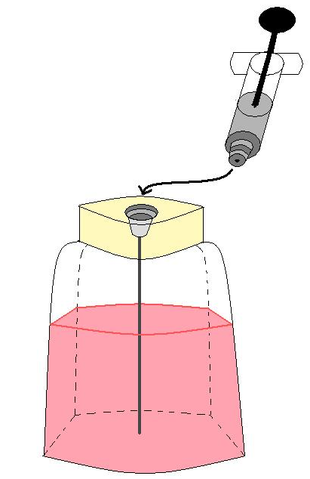
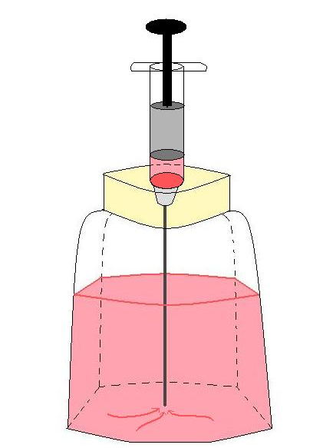
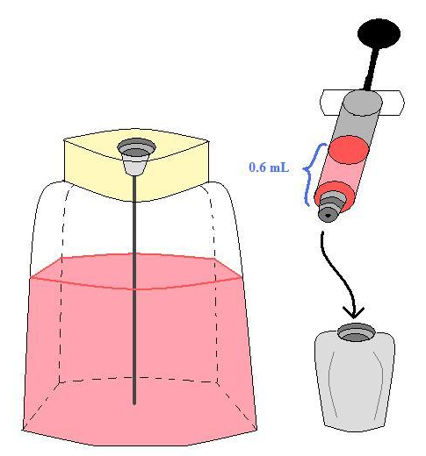
Design 2: The Straw Design
Pros
Accurate and reliable
Minimal viscosity concerns
Cons
Multi-step process
Requires manufacturing
Sterility concerns

Slide 8
Design 3: Two One-way Valves
Pros
Cons
Simple to manufacture
Valves may be expensive
Independent of viscosity
Can be simplified for local manufacture

Slide 9
Valve Options
Ball Valve
Single Flapper Valve
Double Flapper Valve
Pros
Pros
Pros
Least variable
Easily made
Readily Available
Cons
Cons
Cons
Variable
Most variable

Slide 10
Design Matrix
Design | Cost (out of 35) | Accuracy (out of 25) | Reliability (out of 25) | Ease of Use (out of 15) | Total (out of 100)
Horizontal Syringe | 17 | 20 | 20 | 5 | 62
Straw Design | 25 | 25 | 23 | 10 | 83
Two One-Way Valves | 25 | 25 | 25 | 15 | 90

Slide 11
Future Work
Purchase materials and construct prototype
Procure or synthesize appropriate medication analog
Test device for accuracy and reliability
Evaluate valves
Make necessary modifications
Submit to EWH

Slide 12
Questions?

Slide 13
Acknowledgements
Dr. Webster
Engineering World Health
Justin Cooper
Dr. Malkin
Previous Design Team

Slide 14
References
Engineering World Health (2009). “Engineering World Health: Senior Design Projects That Matter. ” Engineering World Health. Accessed Oct. 15, 2009, at <http://216.92.64.45/uploads/docs//09-10_EWH_Projects_that_Matter.pdf>
Feest, A., Maharaj, V., Mogen, B., Cira, N. 2008. “Final Report.” Accessed Nov. 19, 2009, at <http://homepages.cae.wisc.edu/~bme300/ewh_f08/secure/reports/ Final_Paper.pdf>

