Slide 1
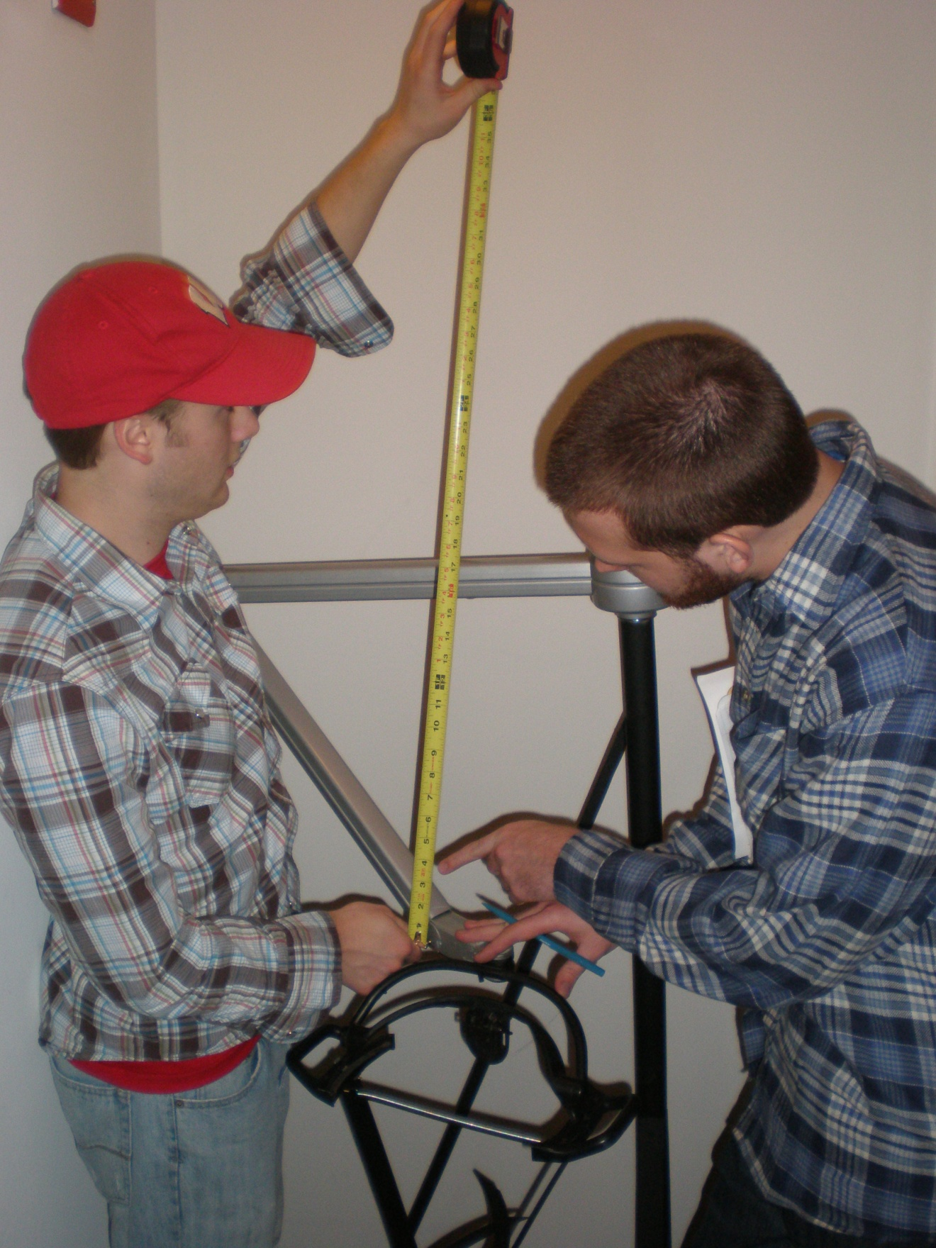
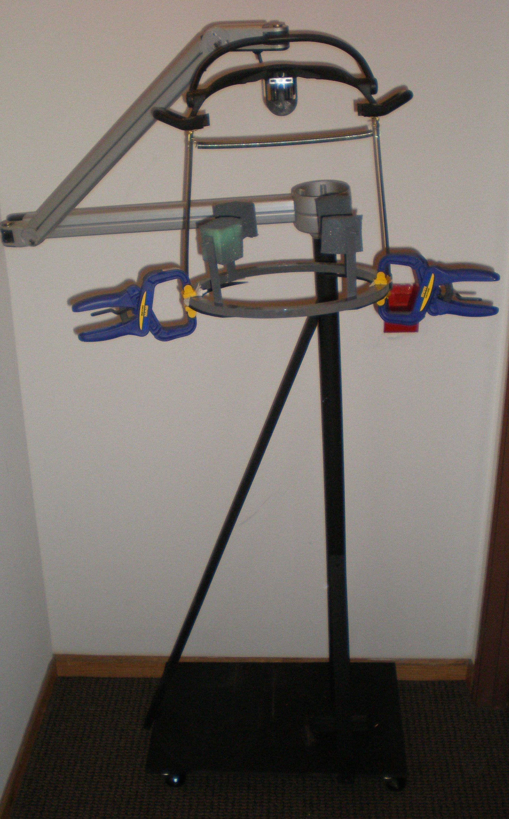
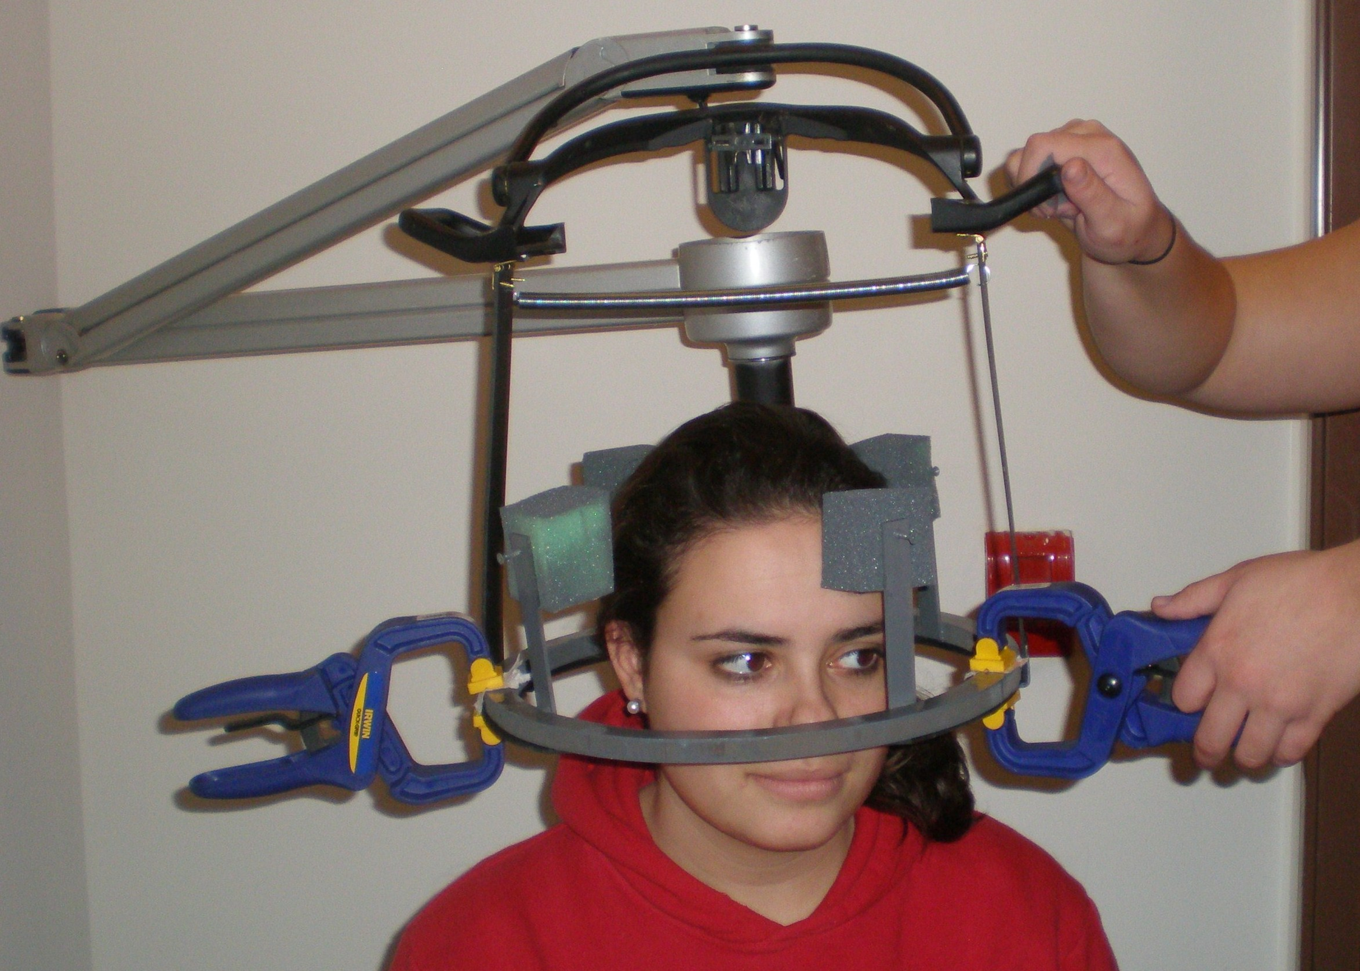
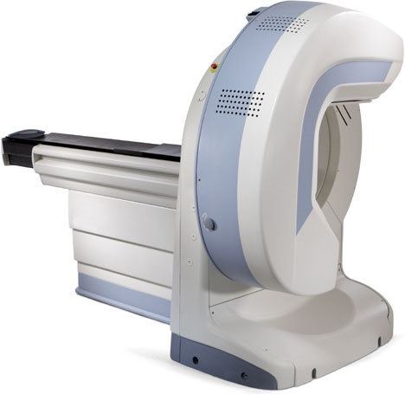
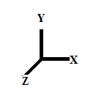
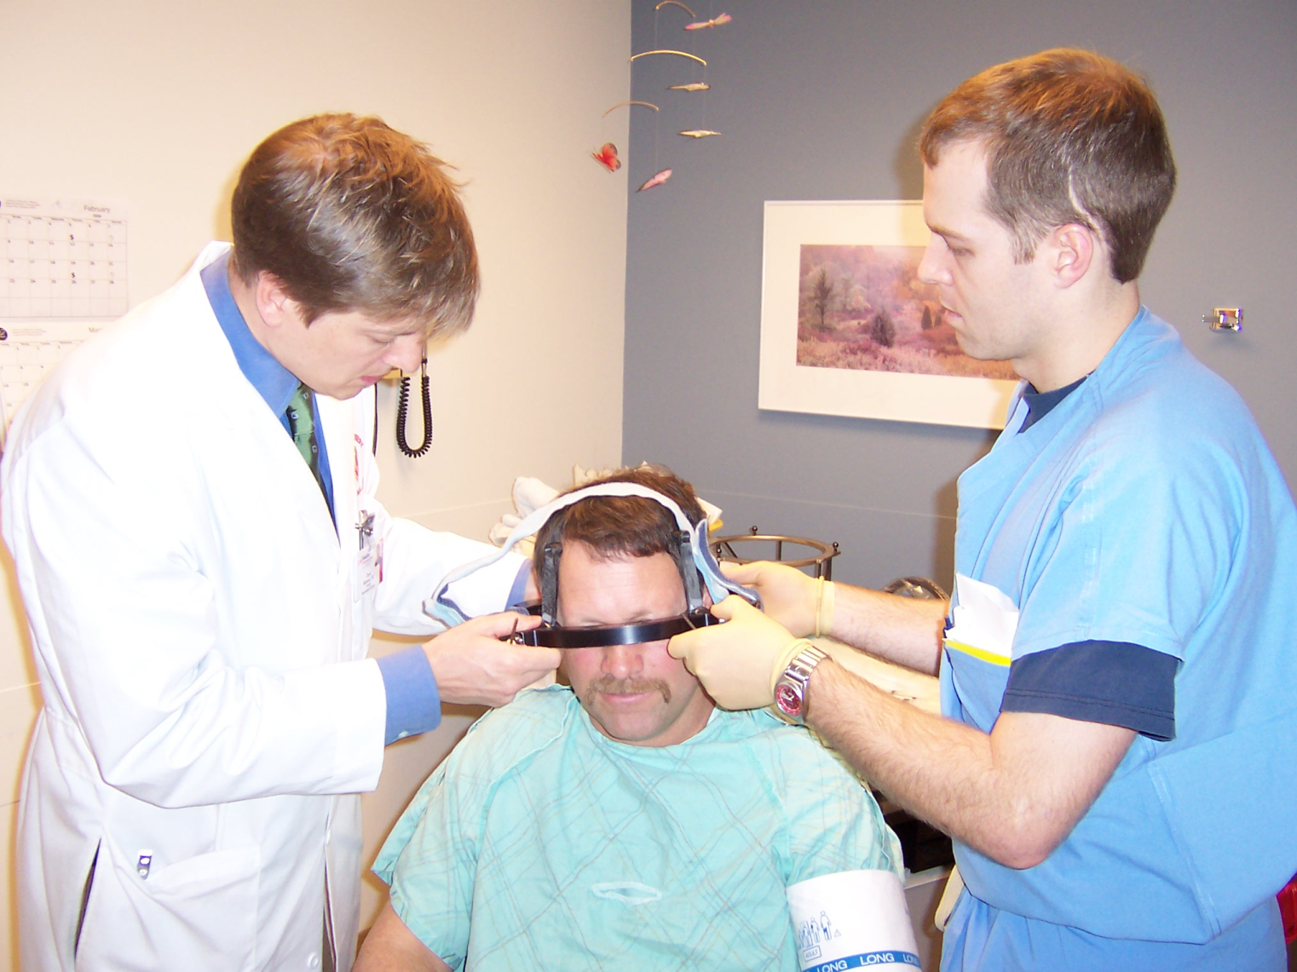
Stereotactic Radiosurgery Head Frame Holder
Justin Cacciatore, Rebecca Clayman, Bret Olson, Katie Pollock
Department of Biomedical Engineering Advisor: Wally Block Client: Lori Hayes, MS R.N.
Abstract
Final Design: Articulating Dental Arm
Frame Holder Testing
Stereotactic Radiosurgery is a precise method of delivering radiation therapy to a patient with malformations (such as tumors) in the brain. At the UW hospital, a linear accelerator focuses beams of radiation onto the tumor to damage DNA so that cells within the tumor are not able to further replicate and cause harm to the patient. To map the location of the tumor, the patient wears a halo. The halo is positioned by tightening four precision screws into the patient’s skull. This procedure currently requires two medical personnel. Our team fabricated a device that holds the halo while a single physician secures it into place. This device utilizes an articulating dental operatory light arm to maximize the motion of the arm. The halo will be attached to the device via clamps. This device will allow the halo to be attached to the patient in preparation for stereotactic radiosurgery, while utilizing physician time efficiently.
Time Testing
Test using a Mannequin to assess speed of procedure using head frame holder
Separate test of prototype movement to simulate transfer between hospital rooms
Average Velocity =0.4204m/s
Stability Testing
Arm can rotate 90° and translate 68.58cm (maximum Z translation) for use of halo attachment
Arm can extend a total length of 4ft.
Physician Testing
Ease of use determined by Physicians performing procedure
Articulating Dental Light Arm
Picture of Device
Five Degrees of Freedom
X-Translation-unlimited
Y-Translation-unlimited
Z-Translation-68.58cm
Z-Rotation-360°
Pitch >90°
Patient location independent of mechanism location
Joints are non-rigid; do not lock
Procedure Requirements
When a patient has a tumor in the brain, one way to reduce the size of the malformation is stereotactic radiosurgery. Stereotactic radiosurgery is a method of delivering radiation to a patient in an extremely precise manner using a linear accelerator. When the radiosurgery is performed, a halo “ring” is attached by two physicians to the patients scalp and a box shaped head frame is attached to the skull. Our goal is to design a mechanism that stabilizes the head and the frame that allows a single surgeon to adjust the frame independent of head position.
Head Frame Holder
Mock Head Frame
Future Work
Stereotactic Radiosurgery
Spacing bars allow for head height
Hinges and spring allow spacers to rotate in
Semi-circular plates provide rest for
head frame
Clamps hold head frame securely in place
Head rest
A solution for the head rest that is not patient reliant can be fabricated and incorporated.
Incorporation
After testing, the device may be incorporated into the surgical procedure for head frame placement at the University of Wisconsin Hospital.
Distribution
If the device is successful, more may be produced for use in other hospitals with streamlined pieces.
Non-invasive procedure performed on patients with benign tumors, malignant tumors, or arteriovenous malformations
Deliver high doses of radiation without damaging surrounding brain tissue
Titanium halo attached by conical, t-bolt screws to the patients head
The patient is locally anesthetized while the four screws are drilled into the skull.
4 Phase procedure:
Head Frame Attachment
Imaging
Computerized Dose Planning
Radiation Delivery
This procedure is performed 50 – 60 times each year in the UW Radiology Department.
Translating Stand
Four locking wheels
Stability-weighted down with bricks
PVC pipe stand
Supported on three sides with supports
Kick Stands
Figure 2. Linear Accelerator used in Stereotactic Radiosurgery http://www.peninsula.org/images/cancer_center/Trilogy%20Linear%20Accelerator2.jpg
Client Requirements
Cost Analysis
References/Acknowledgements
MDF (Wood for base)-$8.31
PVC pipe -$2.94
PVC sheeting -$11.91
Hinges-$2.47
Wheels-$15.92
Clamps-$11.94
Screws-$.98
L-brackets(small)-$2.98
Spray Paint-$5.27
Wood(supports) -$1.97
Spring-$1.50
Dental Arm-$75.00
Weights-$2.73
Comprehensive quality assurance for stereotactic radiosurgery treatments
R Ramaseshan et al 2003 Phys. Med. Biol. 48 N199-N205 doi: 10.1088/0031-9155/48/14/402
K&J Magnetics Inc. Jamison, PA. www.kjmagnetics.com
Peachtree Woodworking Supply Inc. Atlanta , GA. ©2001-2008. www.justclamps.com
Stereotaxy Product Catalog. http://www.radionics.com/products/stereotaxy/CRW_Catalog.pdf
http://www.kabdental.com/small-dental-equipment/lighting-reflectors-shields/beaver8.jpg
Lori Hayes, MS RN and the University of Wisconsin Hospital Radiosurgery Department
Associate Professor Wally Block
Adjustable
Up to 45° Angle Recline
Vertical translation 4-5 inches
Access to 4 pins
Neck support for sedated patient
One Physician
Used 50-60 times a year
Total Cost: $152.22
http://www.kabdental.com/small-dental-equipment/lighting-reflectors-shields/beaver8.jpg

