Slide 1
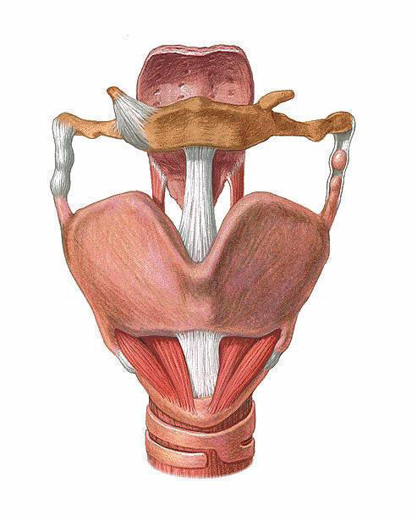
Controlled Testing Environment for Measuring Larynx Phonation Pressure
Team Members
Whitney Johnson, Sarah Switalski , Kelsey Hoegh, Clayton Lepak, Jack Renfrew
Client
Jack J Jiang MD, PhD
Department of Surgery and Otolaryngology
Advisor
Professor Thomas Yen
Department of Biomedical Engineering

Slide 2
Overview
Background
Problem Statement
Design Specifications
Current Testing Device
Design Alternatives
Decision Matrix
Final Design
Future Work

Slide 3
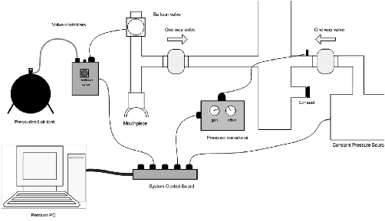
Background
Device to measure vocal efficiency
Evaluation of laryngeal health
Diagnostic potential
Noninvasive
Minimal training
required
http://www3.interscience.wiley.com/cgi-bin/fulltext/121606890/PDFSTART

Slide 4
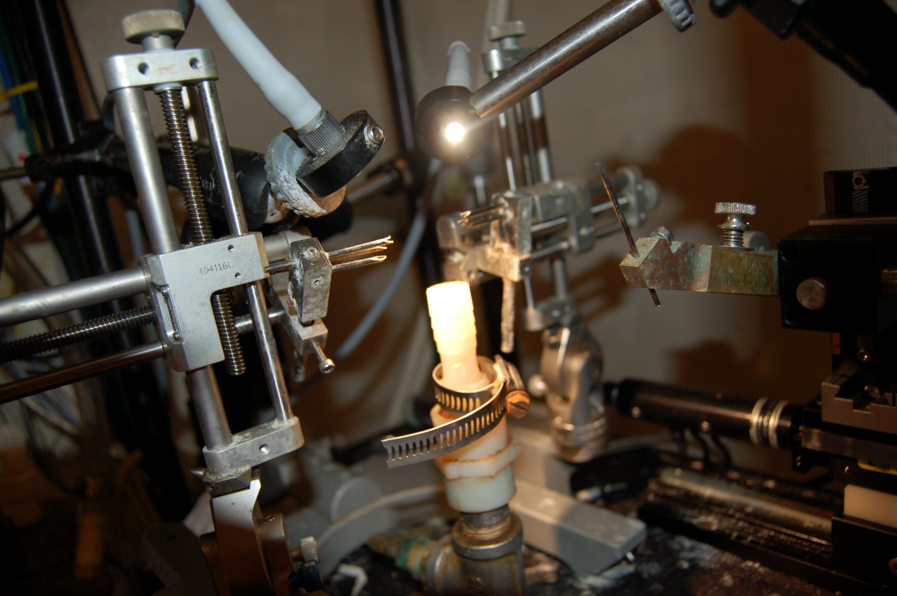
Problem Statement
Interface between excised larynx and testing apparatus
More controlled testing environment
Airtight, rigid, transparent enclosure
Allow for manipulation of vocal folds
Picture courtesy of Adam Reeves

Slide 5
Design Specifications
Max volume = 200 cm³
Airtight, rigid
Withstand 100 cm H₂O
Compatible with current
testing apparatus
Transparent
Accessible during testing
Manipulate larynx shape
Up to 3 cm in x-y-z directions

Slide 6
Current Testing Device
Camera
Positioning system
Prongs
Plastic Tubing
Photos courtesy of Adam Reeves

Slide 7
Design Schematic
Plexiglas Enclosure
Main variable for design choices – 3-D positioning system

Slide 8
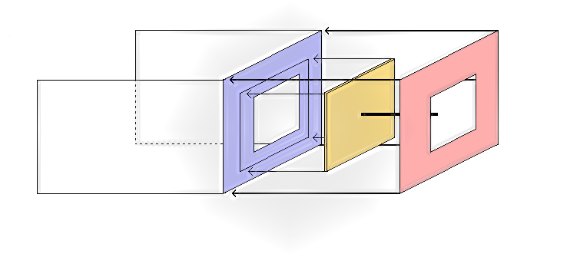
Design 1 – Translating Plate
Lubricant in empty space
Rubber seals
“Tube within a tube” z- axis positioning

Slide 9
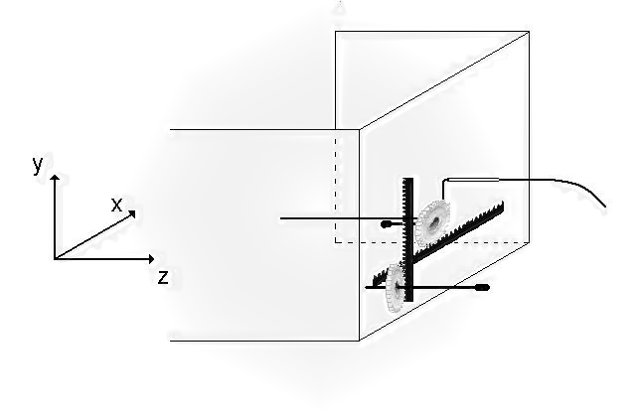
Design 2 – Rack and Pinion
x-axis rack and pinion translates with y-axis positioning
Z-axis positioned with flexible string

Slide 10
Design 3 – Complete Enclosure
Notes:
We call our third design the complete enclosure. The complete enclosure is a large box that will entirely enclose the current larynx manipulation system.

Slide 11
Design Matrix
Category | Design 1 “Translating Plate” | Design 2 “Rack and Pinion” | Design 3 “Complete Enclosure”
Small Volume (25) | 25 | 18 | 5
Maintains Airtight Seal (25) | 20 | 22 | 18
Ease of Manufacture (20) | 15 | 10 | 17
Ease of Use (17) | 16 | 14 | 14
Maintenance and Durability (13) | 6 | 11 | 13
Total Score (100) | 82 | 75 | 67
Notes:
The most important characteristics in our design are to have a small volume and to maintain an airtight seal. The translating plate design scored the highest in each of these categories. The score in the small volume category for the complete enclosure immediately shows its greatest weakness – it is far too large to meet the requirements set by the client. The translating plate will be more tedious to clean than the other design and thus scored rather low in the maintenance and durability category. The greatest advantage to the rack and pinion design is that it would better maintain an airtight seal than the other two ____________________________. Overall though, the translating plate design scored the highest with 82 out of 100 possible points.

Slide 12
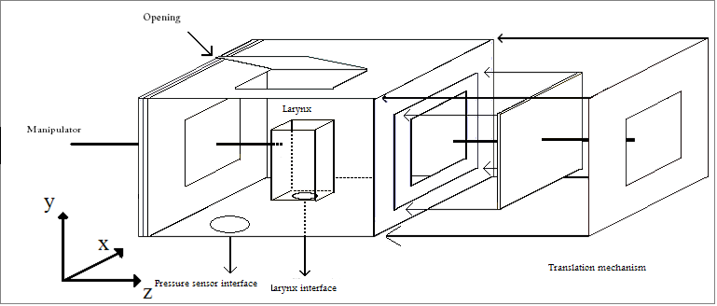
Final Design – Translating Plate
Pseudo lung/larynx interface
Opening for saline solution
Translating plate mechanism
Larynx manipulators
Open view for camera system

Slide 13
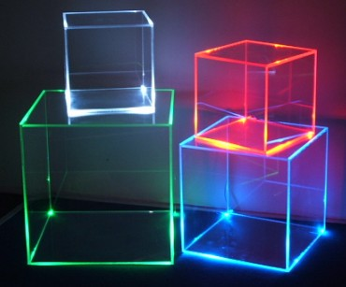
Future Work
Determine average laryngeal volume
Determine appropriate viscous liquid
Construct prototype of positioning mechanism
Modify syringe for translating plate mechanism
www.img.alibaba.com/photo/104715721

Slide 14
References
Hoffman M, Jiang J, Reives A, McElveen K, and Ford C. Differentiating Between and Abductor Spasmodic Dysphoina Using Airflow Interruption. The Laryngoscope. 2009; 119:1851-1855.
Baggott C, Yuen A, Hoffman M, Zhou L, and Jiang J. Estimating Subglottal Pressure via Airflow Redirection. Laryngoscope. 2007; 117:1491-1495.
Rieves A, Regner M, and Jiang J. Phonation Threshold Pressure Estimation Using Electtroglottography in an Airflow Redirection System. Laryngoscope, 2009: 1-6. Print.

Slide 15
Questions?

