Slide 1
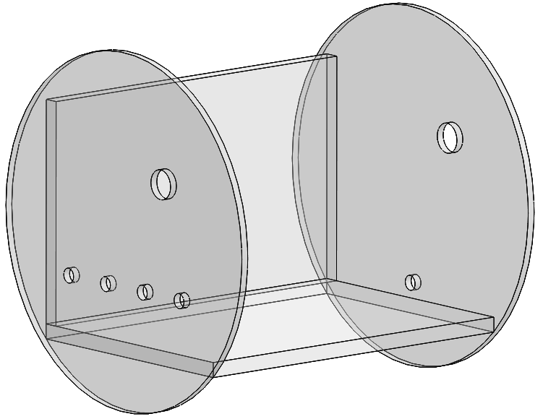
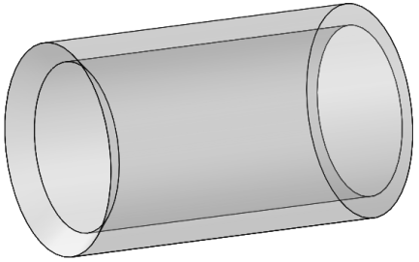
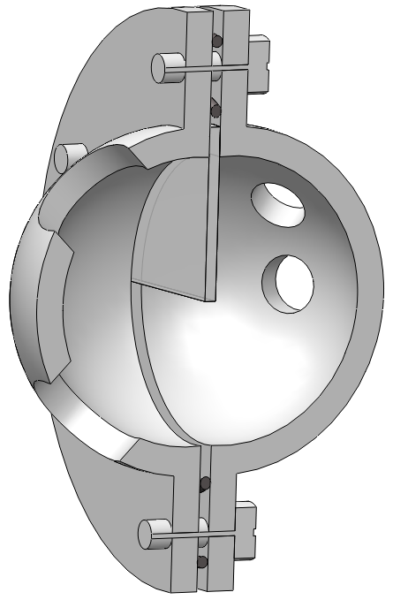
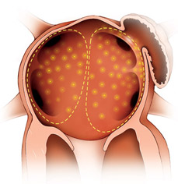
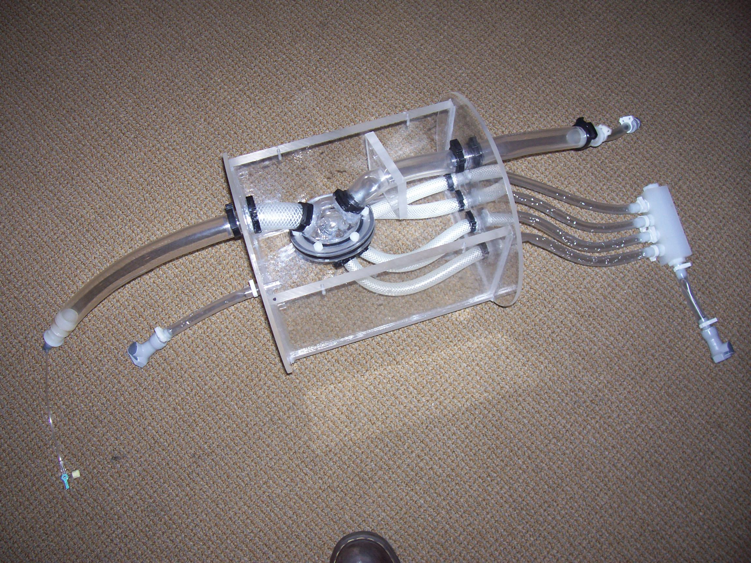
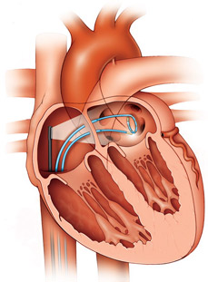
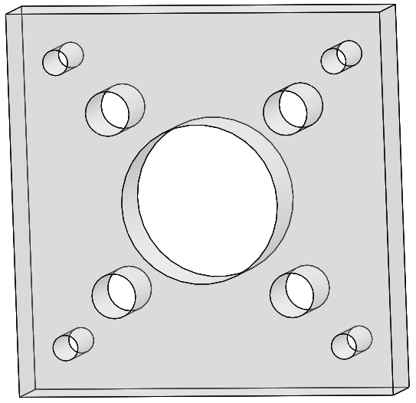
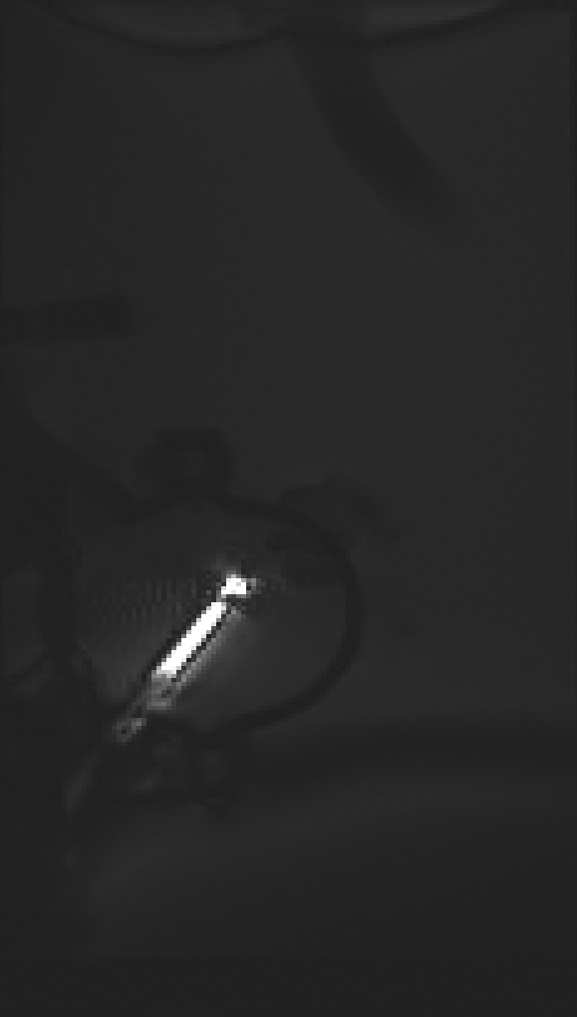
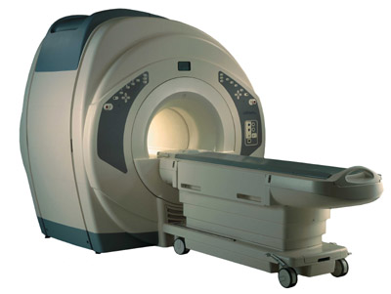
Heart Phantom for MRI Guided Interventions
Team Members: Lacey Halfen, Jessica Hause, Erin Main, Peter Strohm & Fan Wu
Client: Orhan Unal Advisor: Willis Tompkins
Abstract: A recently developed intravenous catheter aims to treat atrial fibrillation under MRI guidance. This device should effectively eliminate the patient’s exposure to X-ray radiation during a traditional intravenous catheterization procedure. The heart phantom design described provides an adequate testing environment for the catheter before animal trials. The dimensions of the phantom’s outer casing fit tightly inside a 13’’ diameter cylindrical coil. The inner contents of the phantom mimic the physiological passage of the catheter into the atria. This internal vasculature was created using flexible and braided tubing, polycarbonate tube inserts and snap grip clamps. Two acrylic hemispheres were combined to resemble the atrial chambers of the heart. An acrylic square with holes of various sizes will allow for high resolution testing in the vicinity of the catheter tip. Initial MRI testing demonstrated that the phantom is completely MRI compatible and is sufficient for testing the catheter under real time MRI imaging.
Problem Statement
Final Design
This project consists of designing a heart phantom to be used for the initial testing of a solenoid-tipped catheter, which will ultimately be used to treat atrial fibrillation under MRI guidance. The phantom will be used to test the maneuverability of the catheter as well as the high resolution imaging capabilities in the vicinity of the solenoid tip. Vasculature must be transparent and mimic the superior and inferior vena cava and pulmonary veins. The heart chamber must consist of the right and left atrial chambers with a disposable septum between.
Tubing Connections
Casing
Snap Grip Clamps
Polycarbonate Tubing
Heart Chamber
Tapered to prevent catheter from catching
Superior Vena Cava
Screws & Bolts
Superior Vena Cava
Inferior Vena Cava
Tygon Tubing
Outlet
Seal heart chamber
Background Information
Outlet
Catheter entry point with sheath
Acrylic Wall
Disposable Septum
Pulmonary Veins
Catheter puncture from right to left atrium
Inlets
Atrial Fibrillation
Characterized by irregular atrial beating, poor blood flow, increased blood clot risk and disordered electrical signals
Complications include stroke (blood clots) and heart failure
Pulmonary Vein Isolation
Catheter Pathway
Enters femoral vein and travels through inferior vena cava to right atrium
Puncture through from right atrium to left atrium
Tissue Ablation
Irregular impulses originate from pulmonary veins
Scaring of heart tissue to isolate irregular signals
Client’s Research
Treatment of atrial fibrillation under MRI guidance using solenoid tipped catheter
Figure 4. Casing of heart phantom.
Drain
Inferior Vena Cava
O-rings
Pulmonary Veins
Catheter entry point
Figure 8. Heart chamber.
Seal heart chamber
Inlets
Vasculature
Fluid Flow & Catheter Pathway
Figure 1. Area in left atrium with tissue ablation occurs.
Pulmonary Veins
½’’ ID tubing
Braid reinforced tygon
Superior Vena Cava
1’’ ID tubing
Tygon
Inferior Vena Cava
1’’ ID tubing
Braid reinforced tygon
Flow Pathway
Catheter Pathway
Figure 6. Heart phantom.
High Resolution Block
Figure 5. Braid reinforced tygon tubing used for the pulmonary veins and inferior vena cava.
Visualization of catheter and surrounding vasculature on MRI
Central hole
Superior vena cava
Small holes
Surrounding vasculature
Figure 9. Fluid flow and catheter pathway through heart chamber.
Figure 2. Location of catheter during pulmonary vein isolation.
Figure 7. High resolution block.
Design Constraints
Testing
Future Work
Size
Diameter 13’’
Length 13’’
Vasculature
Pulmonary Veins: inlets
10 – 20 mm (diameter)
Superior Vena Cava: outlet
20 – 30 mm (diameter)
Inferior Vena Cava: catheter entry point
20 – 30 mm (diameter)
Heart chamber division
Thin disposable membrane
MRI compatible (no ferrous materials)
Transparent and leak proof
Leak Testing
casing, vasculature and heart chamber
Flow Testing
dynamic pressurized state using pump
vasculature completely filled with water
MRI Testing
superimposed images from two coils
catheter imaging coil
small field of view
bright image of catheter
large imaging coil surrounding phantom
large field of view
tracking coil on tip of catheter
real time tracking with software
visual feedback during catheterization
Replace caulking in heart with softer, better sealing o-rings for quicker removal and replacement
Decrease size of casing to fit into client’s new smaller coil
Flow testing with catheter puncturing septum
References & Acknowledgements
Mayo Clinic Staff (2007) Heart Disease: Atrial Fibrillation. Retrieved February, 2009, from http://www.mayoclinic.com/
http://www.pic-see.com/MRI_s__CT___Ultrasound.html
http://www.cpmc.org/services/heart/tx/pvai.html
We would like to thank our client Orhan Unal for his help and support during the past two semester, as well as our advisor Willis Tompkins for his guidance.
Figure 3. MRI machine that will be used in the testing of the heart phantom.
Figure 10. MRI image of catheter.

